Slide 1

Statistics, Machine Learning, and AI in Accounting
An Introduction to Modern Data-Driven Approaches in Accounting
An MC Escher depiction of AI thinking about itself

Slide 2
Agenda
Who is this guy?
Why am I here?
The role of statistics in accounting
How AI is revolutionizing accounting
Challenges and opportunities
Okay... But how do I get started?
Getting Started with Python
Is it over yet?

Slide 3
Agenda
Who is this guy?
Why am I here?
The role of statistics & ML in accounting
How AI is revolutionizing accounting
Challenges and opportunities
Okay... But how do I get started?
Getting Started with Python
Is it over yet?
3

Slide 4
Who is this guy?

Slide 5

Who is this guy?
Background
B.S: Physics, Rose-Hulman Institute of Technology
Ph.D.: Biostatistics, Indiana University School of Medicine
Computation & High-Dimensional Statistics
Family
Hobbies
Brazilian jiu-jitsu
Cycling
Work
Data Scientist Manager, CliftonLarsonAllen LLP
Notes:
Alex is a data scientist manager with extensive expertise in statistics, artificial intelligence, and machine learning. He received his BS in Physics from Rose-Hulman Institute of Technology and completed his PhD in Biostatistics at Indiana University School of Medicine. Alex's research has focused on developing advanced statistical models to analyze high-dimensional and heterogeneous genetic data. He has published his work in scientific journals and has presented at numerous conferences. As a data scientist manager at CLA, Alex collaborates with clients to develop customized solutions that leverage his expertise in statistics, AI, and machine learning to drive actionable insights and informed decision-making.

Slide 6
Why am I here?

Slide 7
Statistics, Machine Learning, and AI
Statistics
Mathematics of data collection & analysis.
Describes and infers trends from data.
Machine Learning/AI
Algorithms learn from data patterns.
Types: Supervised, Unsupervised, Reinforcement.
Computer vision, Large Language Models, etc.

Slide 8
Statistical Analysis in Accounting
Improved decision-making
Risk assessment and management
Budgeting accuracy
Fraud detection using anomaly detection
Predictive analytics for revenue forecasting

Slide 9
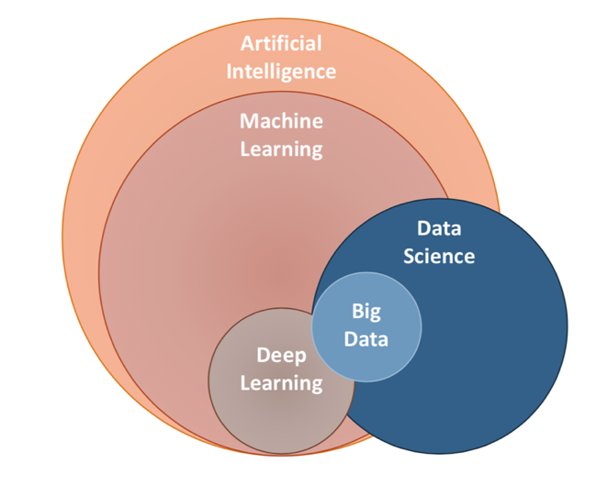
Artificial Intelligence

Slide 10
AI in Accounting
Advanced financial modeling using deep learning
Automated data entry using image recognition and large language models
Improved accuracy and reduction of human errors
Doer to thinker
Ability to handle and analyze vast amounts of data
Notes:
ADD EXAMPLES

Slide 11
Challenges in Integrating AI and ML in Accounting
Data privacy concerns
Reliability and transparency of AI models
Need for continuous training and updating of models

Slide 12

Opportunities Ahead
AI will not replace humans; humans with AI will replace humans

Slide 13
Conclusion
The convergence of statistics, ML, and AI is inevitable in the accounting domain
Embracing these tools can lead to improved efficiency, accuracy, and decision-making
The future of accounting is data-driven

Slide 14
Okay... But how do I get started?

Slide 15
Getting Started with Python
Installing Python (Jupyter Notebook)
Download Anaconda:
https://www.anaconda.com/download
Installation:
Run the Anaconda installer
Documentation & Help:
Anaconda Navigator
Jupyter Documentation

Slide 16
Is it over yet?

Slide 17
Upcoming Lectures
Use of Analytics by Businesses: AI and Automation
Machine Learning and AI for Automation and Forecasting
Wrap-Up: Successes using Predictive Analytics and AI

